Slide 1

analysis Dietary habits and disease activity in rheumatoid arthritis patients by : Martina Viggiano Alessandro Foffo Vickysingh baghel Professors : Valeria Carla Edefonti Francesca Bravi
---------------------------------------------------------------------------
Universita’ degli studi di Milano

Slide 2

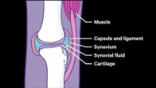
What is Rheumatoid arthritis

Slide 3
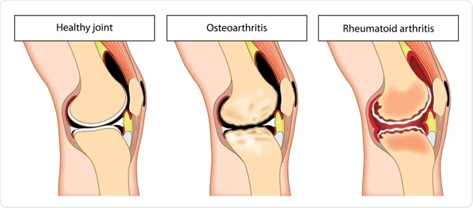
introduction
Rheumatoid arthritis (RA) is a chronic, inflammatory, autoimmune disease that primarily affects the joints
The degeneration and inflammation of joints can cause joint stiffness, pain, swelling, deformity
Also refers to joint damage, such as destruction of cartilage
The global prevalence of the disease is estimated around 1–2%, with a large variation among different populations

Slide 4
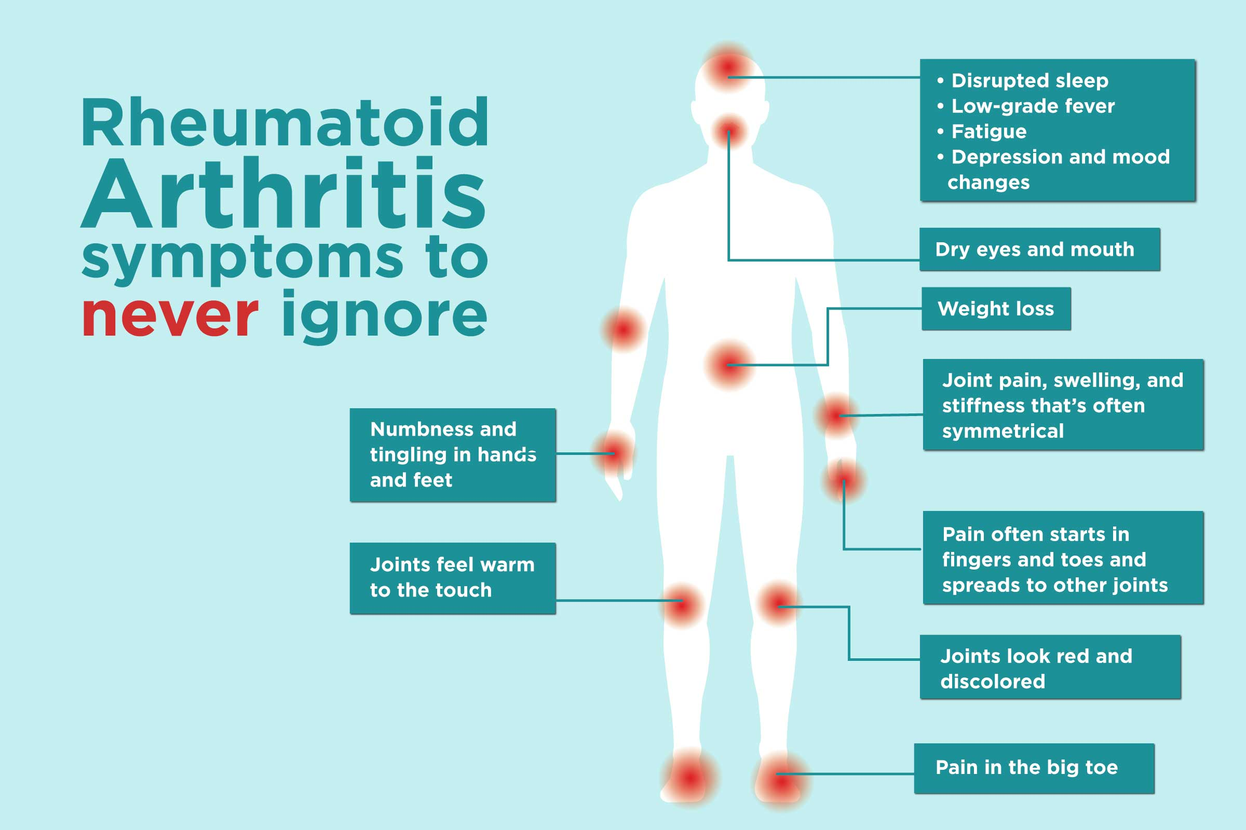

Slide 5
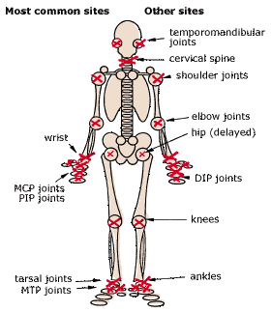
The stages of rheumatoid arthritis
The body mistakenly attacked its on tissue
The body makes the antibodies and start the swelling up
The joint start becoming bent and deformed, the figures become crooked These misshapen joints can press on the nerves and can cause nerve pain as well
If not treated, the diseases will progress to the last stage, in which there no joint remaining at all and the joint is essentially fused

Slide 6
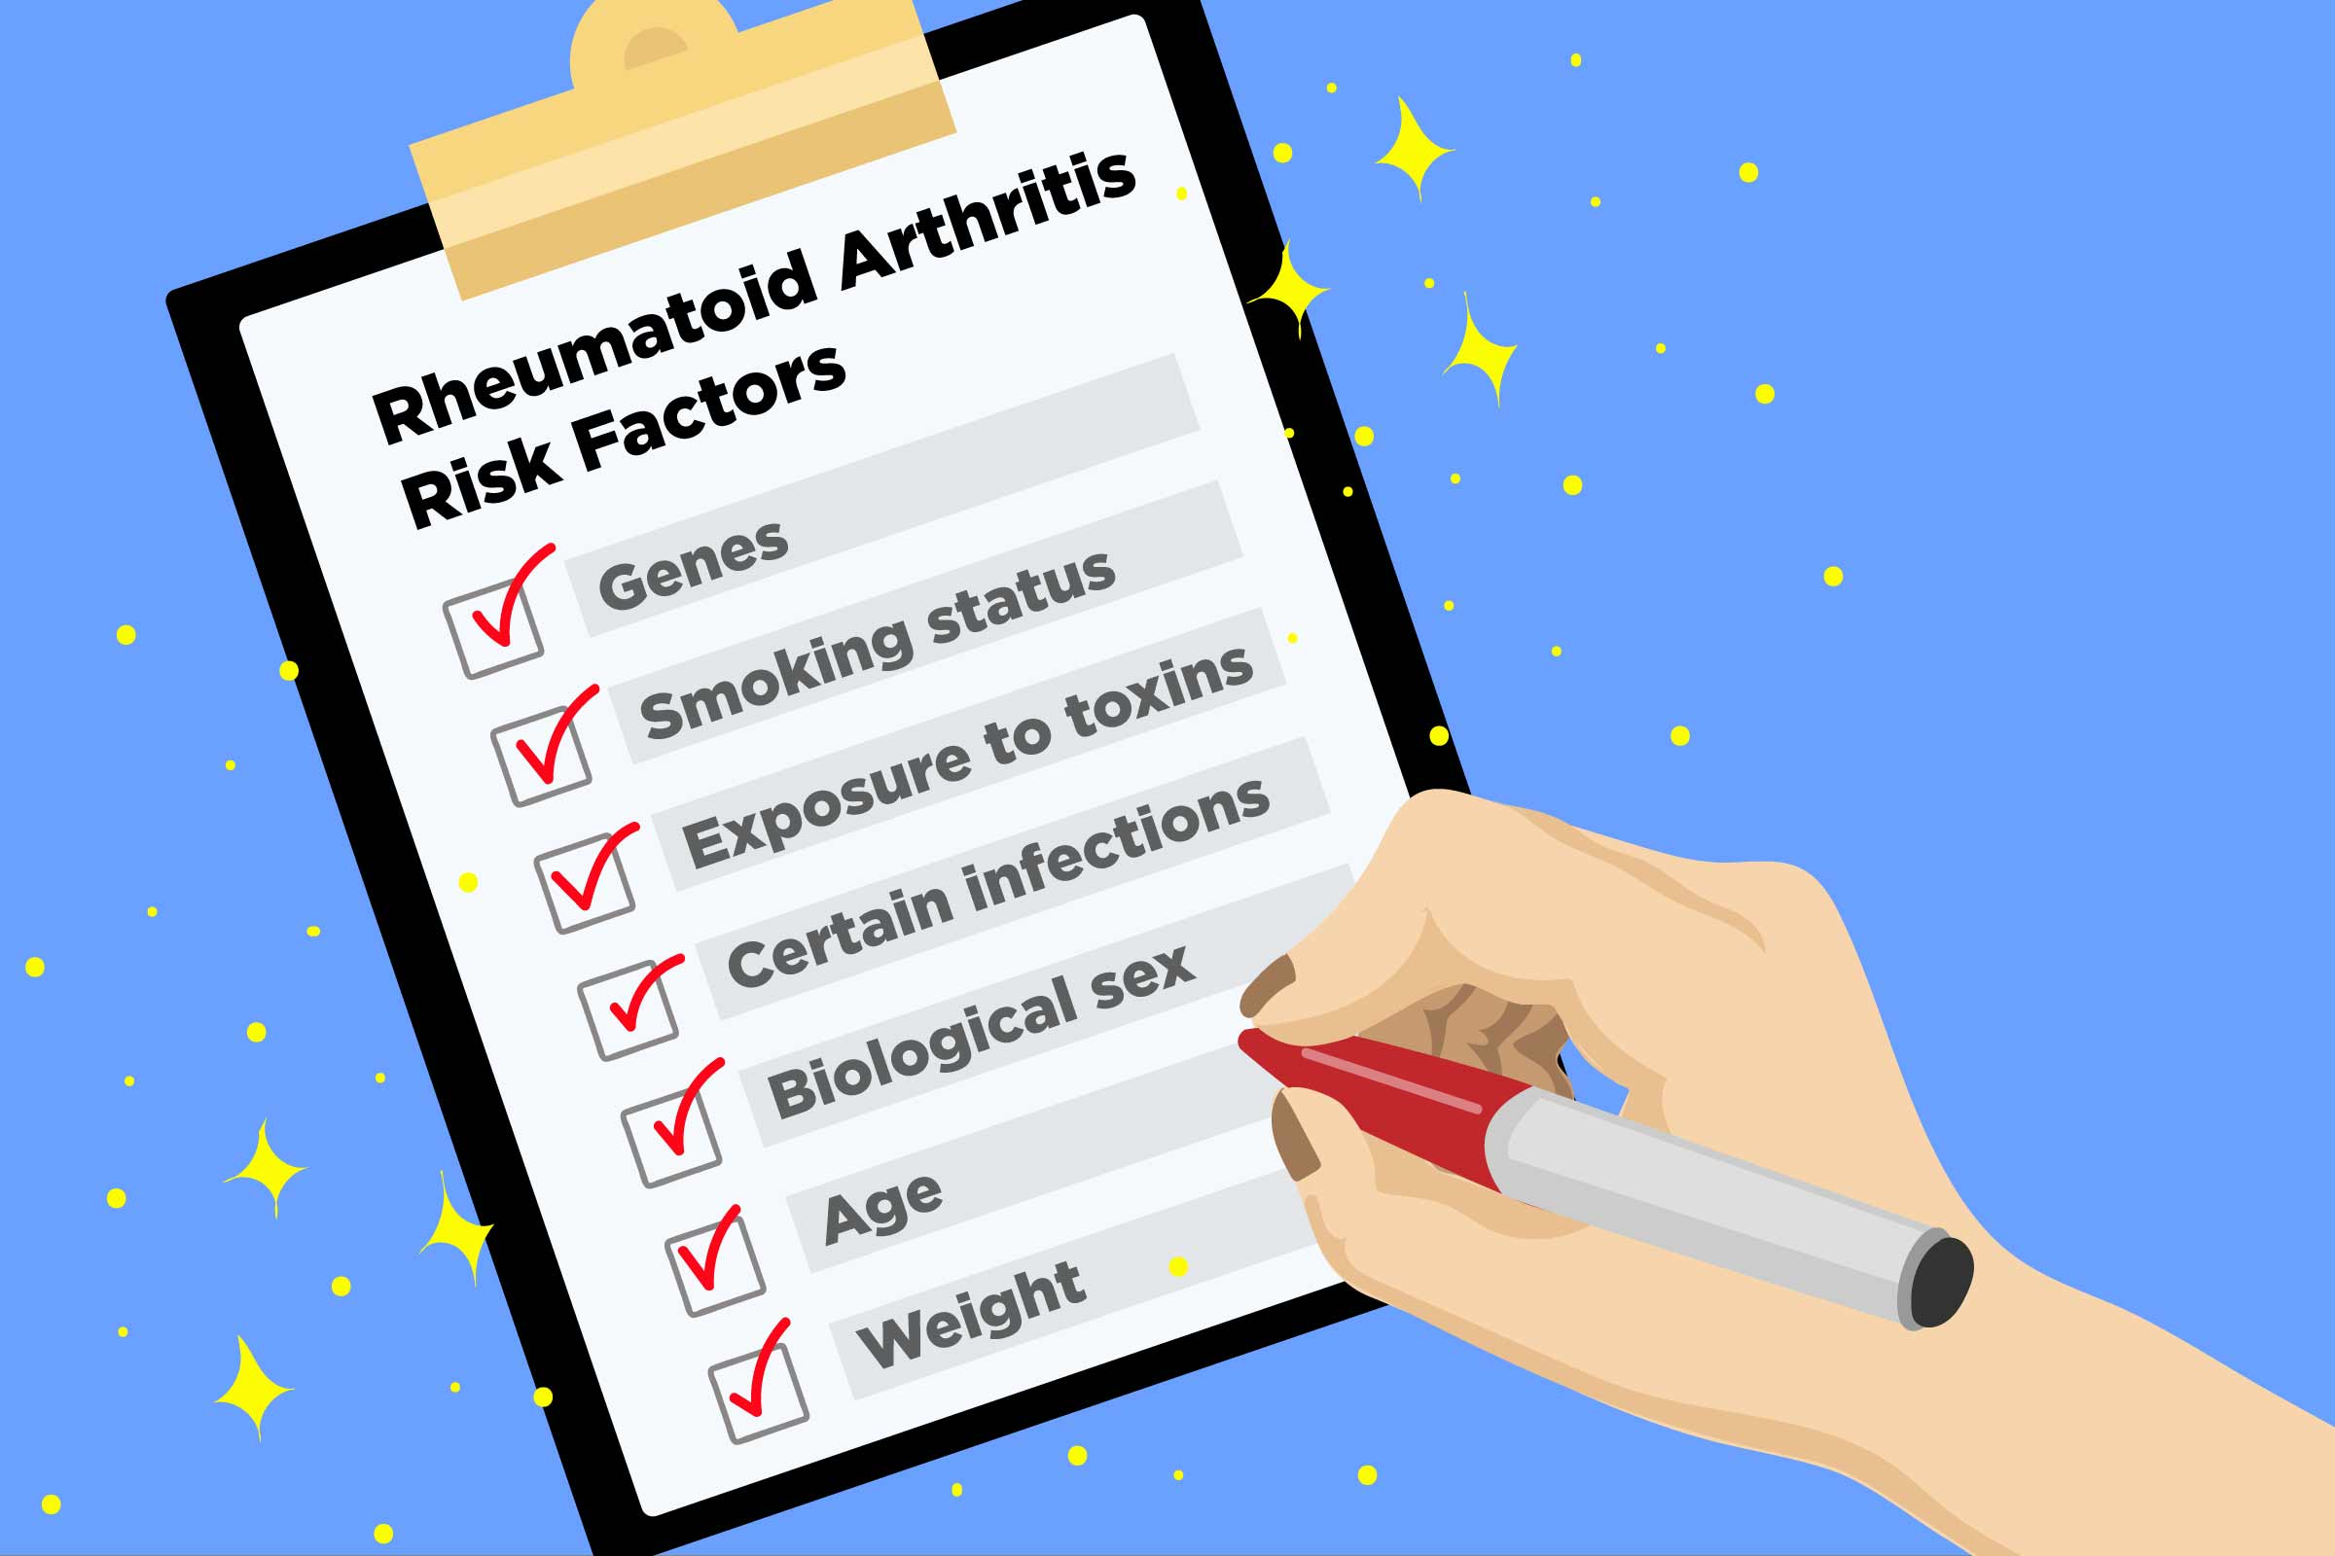
Causes & Risk factors
Rheumatoid arthritis affects adults of any age.
Rheumatoid arthritis is two to three times more common among women than men.
Rheumatoid arthritis develops because of a combination of genetic and environmental factors, such as smoking and diet.
If you are overweight, you have a significantly greater chance of developing rheumatoid arthritis than if you are a healthy weight.
Cigarette smoking significantly increases the risk of developing rheumatoid arthritis.
There is some evidence that if you eat a lot of red meat and don’t consume much vitamin C, you may have an increased risk of developing rheumatoid arthritis.

Slide 7
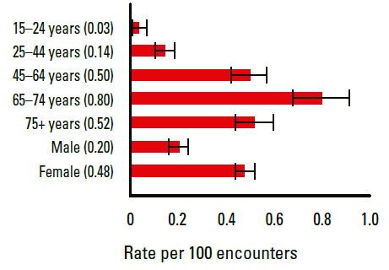
Statistic epidemiology
About 1% of the world population is affected, Women almost 3 times more often than men.
It is 4 times more common among the smokers than nonsmokers.
Genetics and Family history play big role as well.
Onset is uncommon underthe age of 15, however no age is immune.
It is most diagnosed between the age of 40 to 50 years and normally no later than 80years of age.

Slide 8
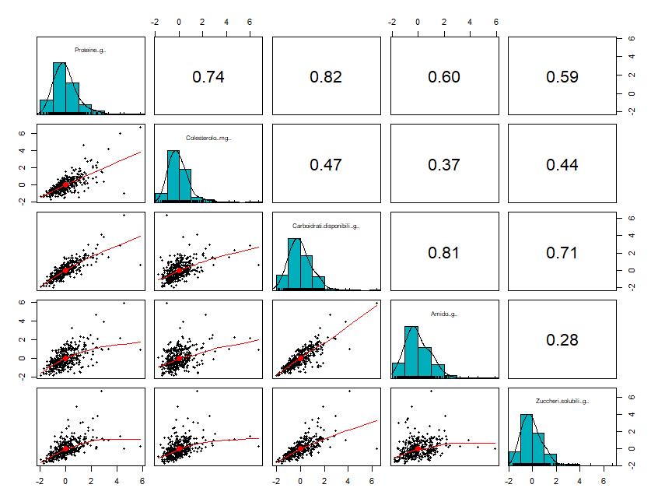
Introducing the project
The dataset provided is composed of 365 observations (subjects) and 499 variables
The variables can be summarized in 7 main groups:
Characteristics of Individuals ad Lifestyle
Activity and Severity of Rheumatoid Arthritis
Comorbidity (Other Diseases)
Drugs taken
Blood Levels
Nutrients
Foods (both singularly taken and in subgroups)
Since they represent different types of properties, some variables are numeric, some others categorical, some others Boolean
Unfortunately some variables have very sparse data
The aim of the project is to make analysis on baseline data in order to study if it is possible to derive a posteriori patterns applying data-driven approaches on the population
Data have been collected with a food-frequency questionnaire referring to eating habits during the year before to the diagnosis of disease

Slide 9
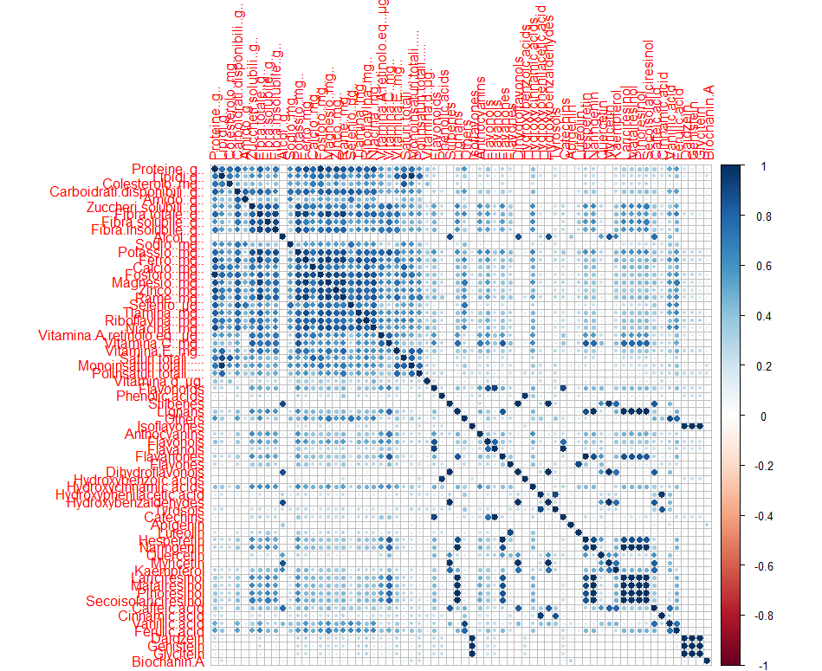
Cleaning data
One of the subjects appeared to have unusual dietary habits: 8010414 declared to eat 4-5 per die oranges, tangerines, broccoli, spinaches, cabbage, cauliflower and other vegetables. For this reason, we decided to exclude the corresponding row
Between nutrients and foods in the dataset, we found some correlations between variables
To remove highly correlated components, we set the cutoff equal to 0.95 and we implemented the selection
The final nutrients table included 49 variables over 87

Slide 10
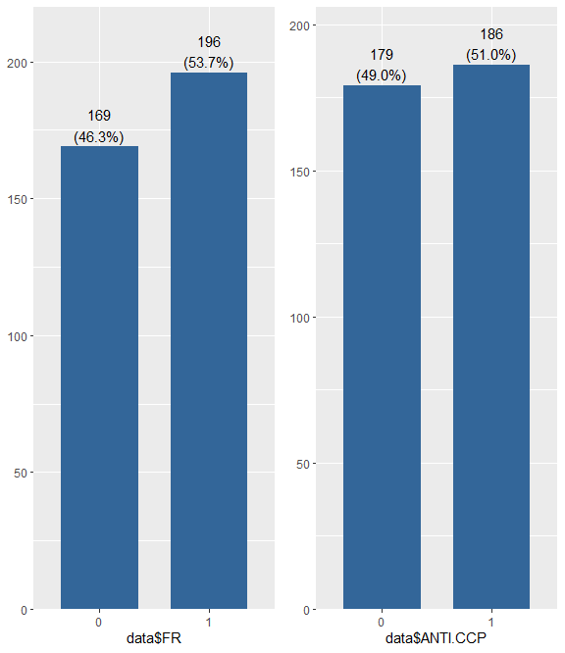
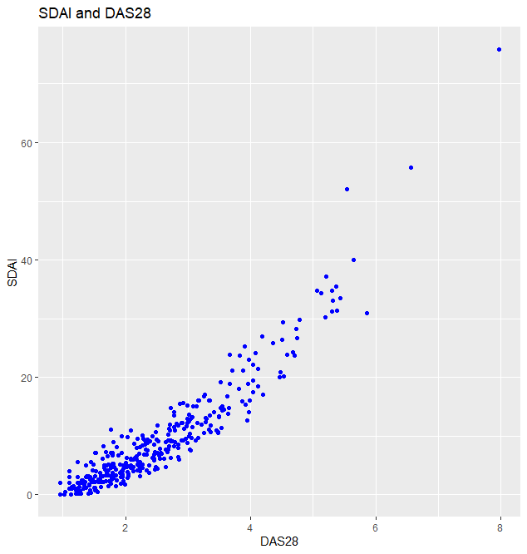
Ra LABEL
Rheumatoid Arthritis can be diagnosed by using several tests, for example detecting rheumatic factor or the antibodies in blood levels
ANTI.CCP (0 - 1) anti-cyclic citrullinated peptide
FR (0 - 1) rheumatic factor
Our aim was also to study the different stages of the disease, then we had to look for other variables:
DAS28 disease activity score over 28 joints (0 Remission – 10 High activity)
SDAI Simple Disease Activity Index (0 Remission – 86 High activity)

Slide 11
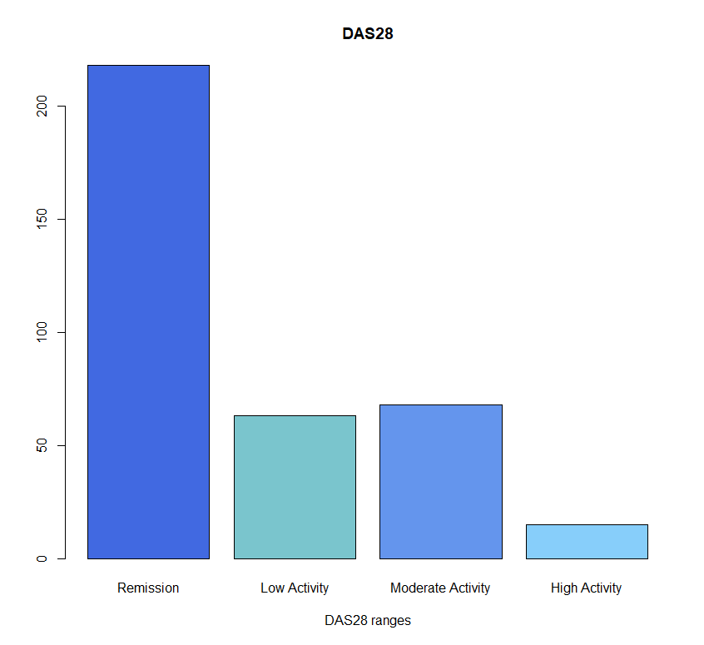
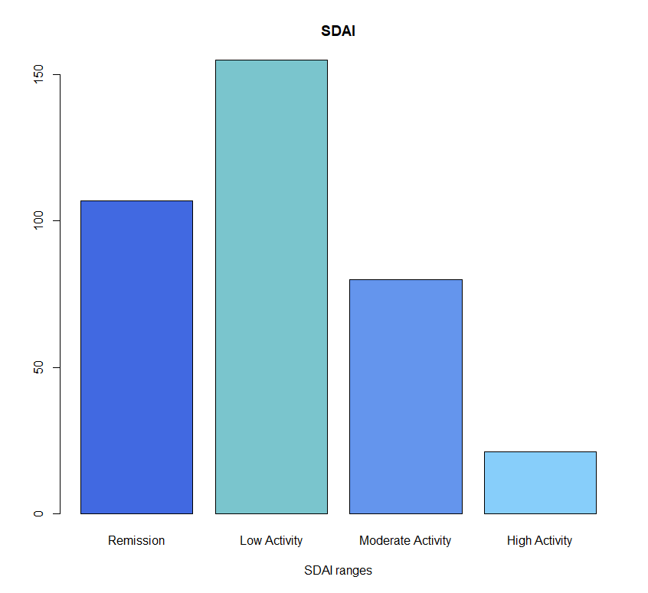
Disease ACTIVITY

Slide 12
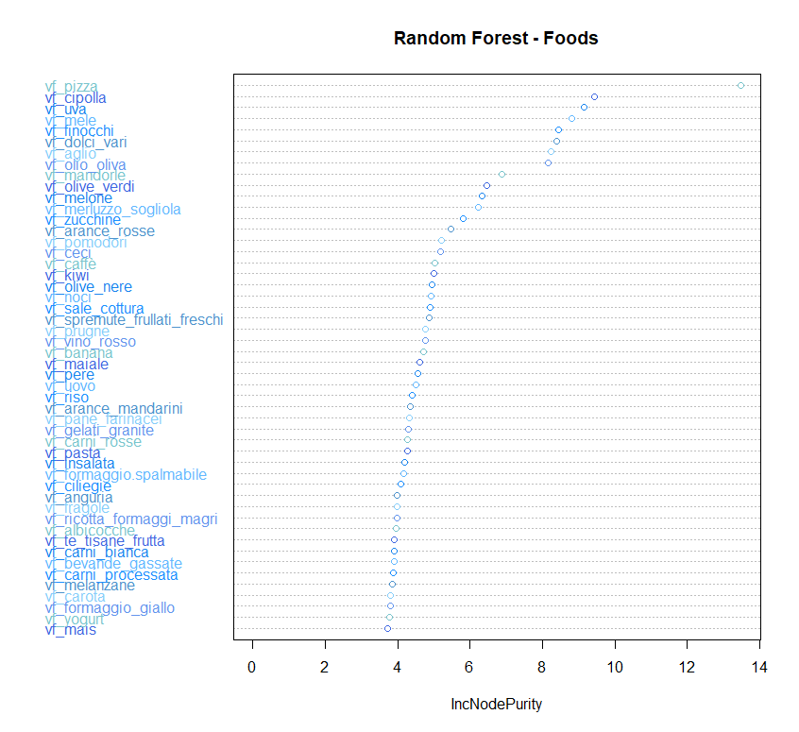
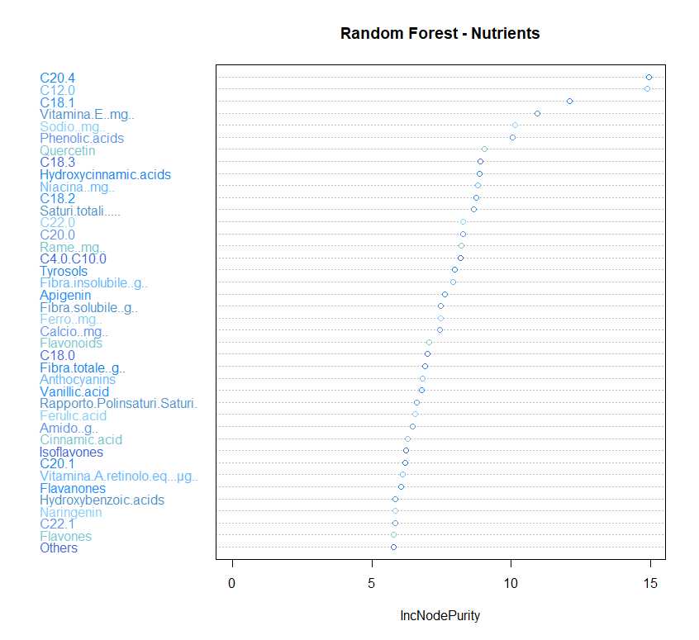
FEATURE SELECTION
One initial analysis was to perform several methods for sorting and selecting a subset containing the most “important” variables, given the label activity of the disease

Slide 13
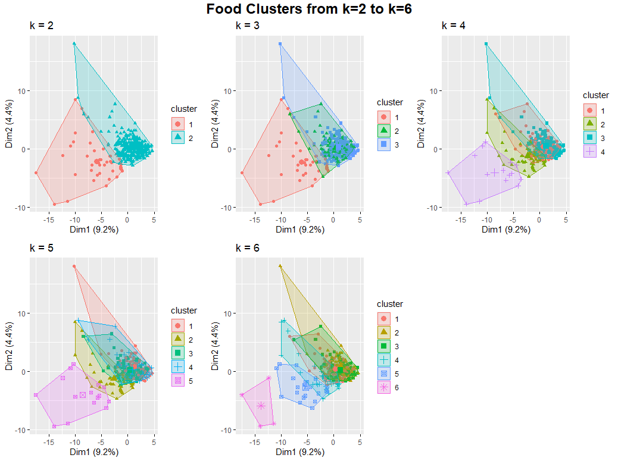
First steps
At first we tried to work on singular foods and groups of foods in order to derive dietary patterns
In terms of significancy the results were weak and, as we can see, we were not able to outline clear and “self contained” clusters
In order to explain 90% of variance, we should have computed 65 components with PCA

Slide 14

STATISTICAL METHODS USED
Principal Component Analysis (PCA) to identifiy dietary patterns.
Linear/Logistic regression to correlate the identified dietary patterns to RA disease activity.

Slide 15
PCA I
PCA was applied on a subset of the original dataset containing only the NUTRIENTS variables (eg. carbohydrates, proteins, lipids, ecc.).
Since many of these variables had a very high correlation, a selection process was implemented so that if two variables had a correlation larger than 0.95, only one of them was picked.
The final data set included 49 variables.

Slide 16
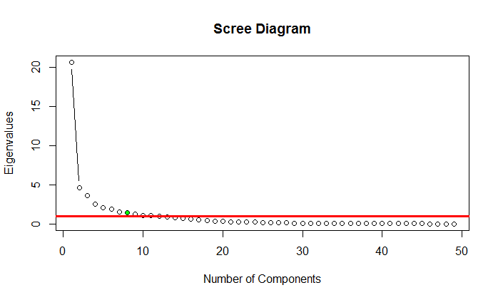
PCA II
PCA was implemented starting from the correlation matrix.
As it can be seen in the scree diagram, the number of components with eigenvalue larger than 1 was 8.

Slide 17
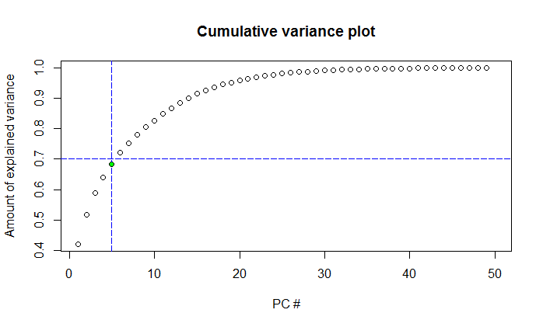
PCA III
In turn, the proportion of variance explained by the first 5 components was almost 70%.
For this reason, 5 dietary patterns were considered.
Before inspecting their loadings, the correlation between each pattern and RA disease activity was evaluated.
In this way it was possible to focus only on those for which a significant relation with RA existed.

Slide 18
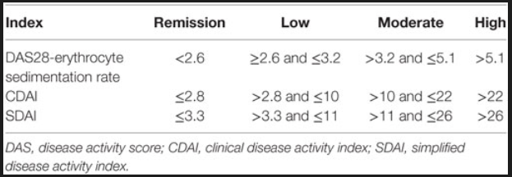
LINEAR AND LOGISTIC REGRESSION I: OUTCOME VARIABLES
To assess the existence of any correlation between RA disease activity and each of the 5 identified dietary patterns, two outcome variables were considered: namely, DAS28 and SDAI.
The first one is an index ranging from 0 (remission) to 10 (most severe form of the disease). Values of the index above 5.1 denotes that the disease activity is high.
The second index ranges from 0.1 to 86. Like in the previous case the index is increasing in disease severity; the threshold of high disease activity is 26.1 in this case.

Slide 19
LINEAR AND LOGISTIC REGRESSION II: NO CONFOUNDING FACTORS
Since the index variables are continuous, they were suitable for both a linear and a logistic regression model.
In particular, in the linear models, a simple regression of the disease score on the dietary pattern considered was carried out.
In the logistic models, instead, the 2 indexes were factorized: namely, a factor with value 1 was assigned to the index values above the high disease activity threshold; 0 to those below.
To be sure to capture statistically meaningful relations, in addition to these two simple models, two more regressions were implemented.
In particular, every dietary pattern variable was factorized: more specifically, the quantcut function was used in order to create 4 factors, one for each quartile of each variable; every observation was assigned to the factor of its corresponding quartile.
Then, a (linear or logistic) regression of the indexes on the previously factorized variables was implemented to evaluate if there was any statistically significant difference in the index values between quartiles.

Slide 20
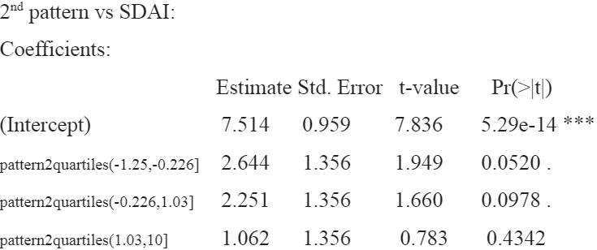
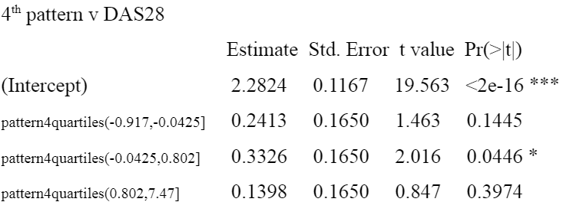
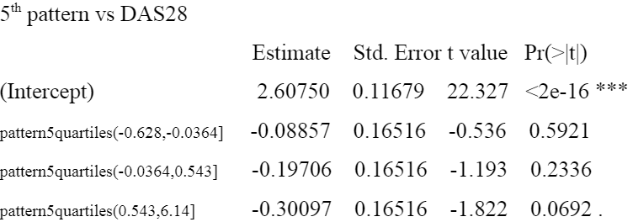
RESULTS
A statistically significant difference between quartiles was registered for Pattern 2, in the linear model where the outcome variable considered was the SDAI index.
For Patterns 4 and 5, instead, in those against the DAS28 index.
As it can be seen in the results shown, Pattern 2 and 4 seem to be positively related to RA disease activity.
Pattern 5 instead seems to have a negative association.

Slide 21
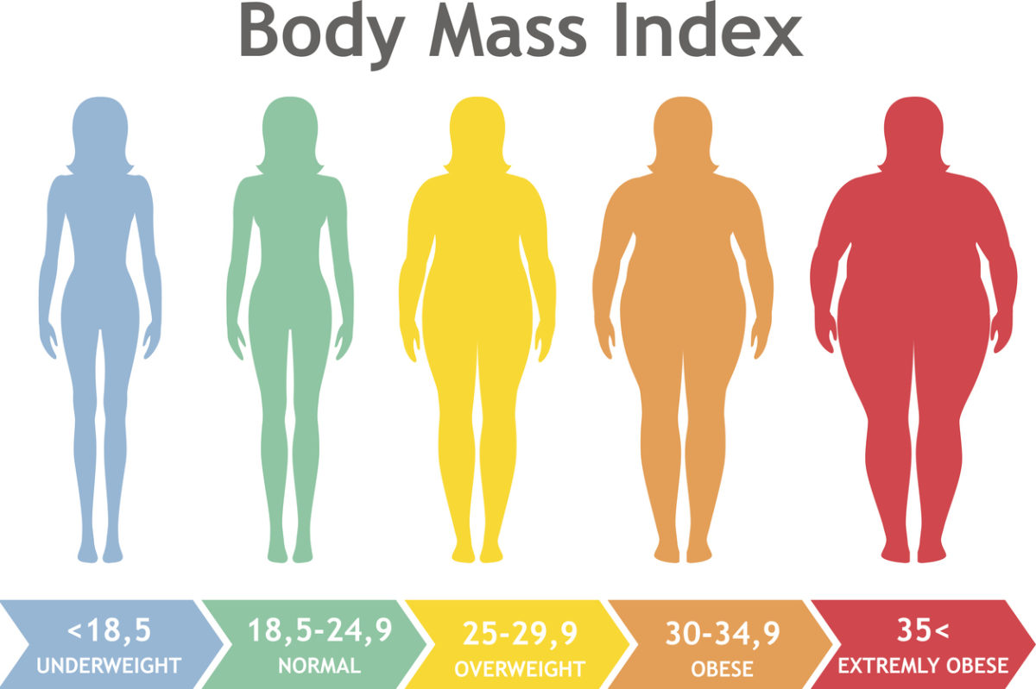


LINEAR AND LOGISTIC REGRESSION III: CONFOUNDING FACTORS
To corroborate the robustness of the relationships, the same models as before were estimated, but with the addition of some confounding factors.
The aim was to control for the potential correlation of these factors with both diet and the disease.
In particular, the factors that were taken into consideration were: age, sex, BMI, smoking status, education, comorbidities, drugs, drugs taken in the past, use of disinfectants and domestic animals possession.

Slide 22
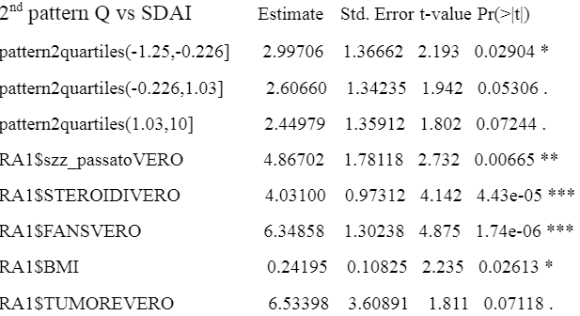
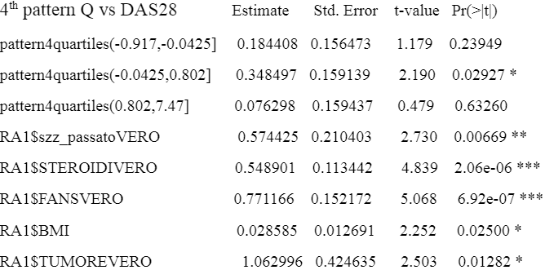
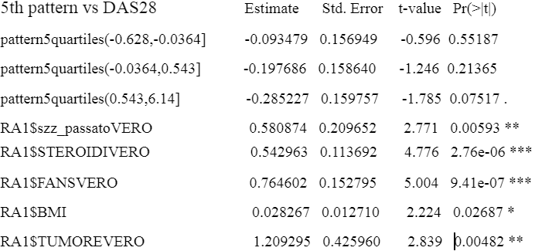
RESULTS I

Slide 23
RESULTS II
Once again, also adjusting for confounding factors, statistically significant differences between quartiles in the mean value (estimates come from the linear model) of the SDAI/DAS28 indexes were found for Patterns 2,4 and 5.
Patterns 2 and 4 seem to be positively correlated with RA disease activity.
Pattern 5 seems to be negatively correlated with RA disease activity.
Among the confounding factors, a positive relation between BMI and disease activity seems to appear repeatedly.
Additionally, RA severity is also positively correlated with the assumption of anti-inflammatory drugs, like FANS and Steroids (which makes sense, because RA is an inflammatory disease).
Finally, cancer seems to be one of the most associated comorbidities.
The regression estimates are reported in the next slide (note that not all confounding factors estimates are listed, but only the most relevant ones).

Slide 24
LINEAR AND LOGISTIC REGRESSION IV: ADJUSTING FOR the OTHER IDENTIFIED PATTERNS
Aim: to check if the previously derived correlations continued to hold even using a measure of RA activity adjusted for all the other patterns identified.
The same models as before were estimated, controlling this time also for all the other patterns (excluding the one used in the model).
The estimates did not change much, both in terms of magnitude and in terms of statistical significance.

Slide 25
DESCRIBING THE RELEVANT DIETARY PATTERNS
As it was said previously, the patterns that have a relevant relationship with the disease activity are the 2nd, 4th and 5th.
In particular, the 2nd one and the 4th one have a positive relation; the 5th one a negative relation (although only weakly statistically significant).
Inspecting the loadings of the patterns with respect to the nutrients allows to get a first idea of the characteristics of each of them.
The loadings are reported in the tables below.

Slide 26
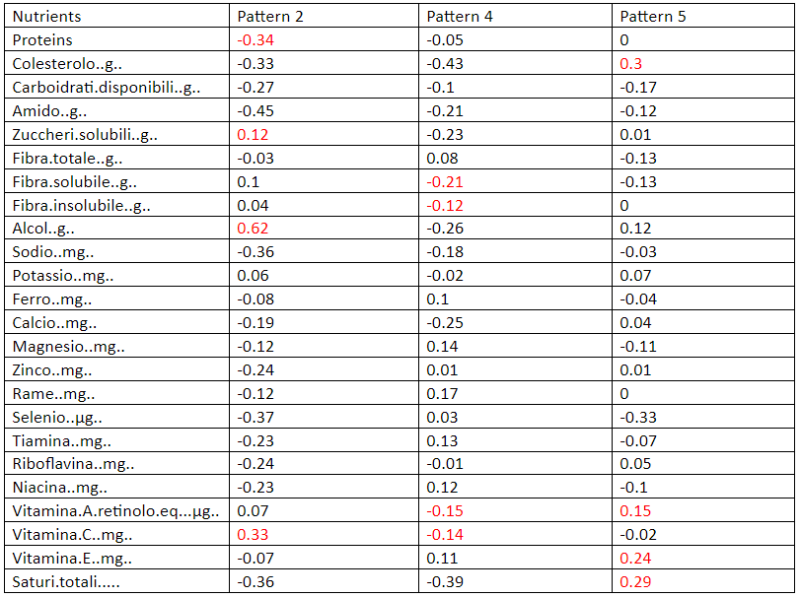
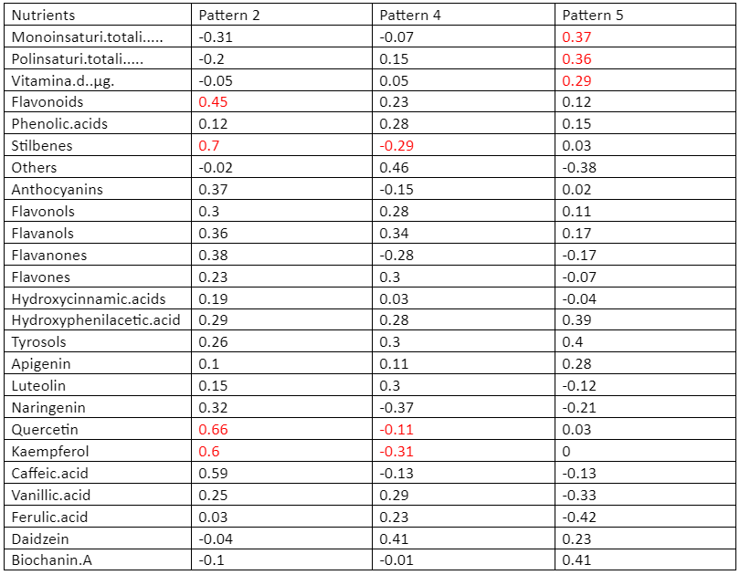
TABLES OF THE LOADINGS FOR PATTERN 2, 4 AND 5

Slide 27
INTERPRETATION OF THE LOADINGS
The 2nd pattern (+ association with the disease) has positive loadings for sugar, alcohol and is negatively correlated with “healthy” fats (unsaturated fatty acids) and proteins.
In the 4th pattern instead (+ association with the disease), we can see negative loadings with respect to some important anti-oxidant flavonoids like quercetin and kaempferol and vitamins like A and C, as well as a 0 loading for vitamin D.
Finally in the 5th pattern (- but weakly significant association), it is relevant to observe a positive loading for fats in general - both “healthy” ones (unsaturated) and “unhealthy” ones (cholesterol, saturated) - and vitamins A,C,D, as well as flavonoids and quercetin.

Slide 28
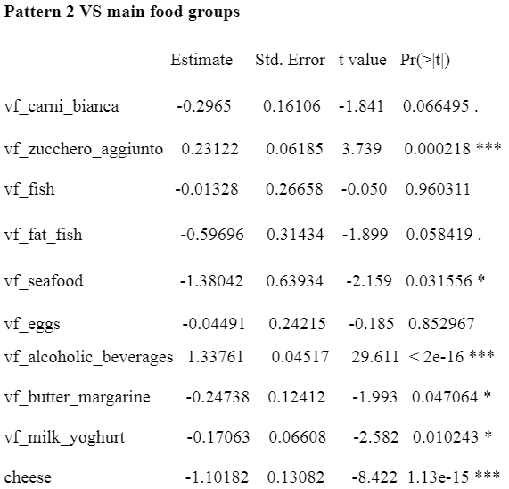
LINEAR REGRESSION OF RELEVANT DIETARY PATTERNS ON FOOD GROUPS (and results)
In order to have a deeper understanding of the foods each pattern is related to, a linear regression was run between each pattern (only those related in a statistically significant way to RA) and the most important food groups.
Some of the estimates (only those relevant to our analysis) are reported (here for pattern 2 and in the next slide for pattern 4 and 5).

Slide 29
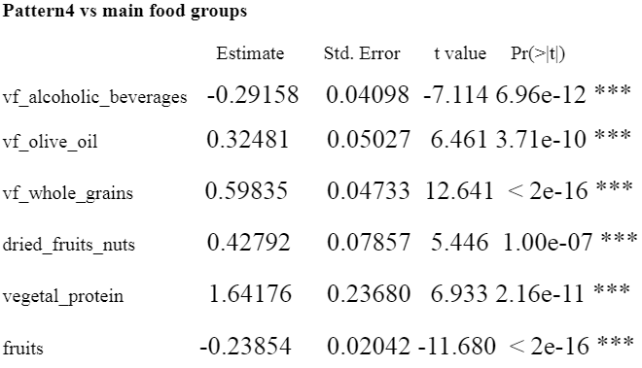
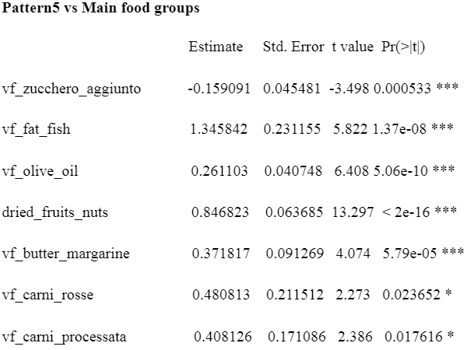
RESULTS

Slide 30
PATTERN 2=VEGAN ALCOHOLIC
Relatively to this pattern, the correlation with alcoholic beverages is positive, large in magnitude and strongly significant.
We can also see a moderate positive correlation with sugar.
Correlation with all animal products (like meat, dairy products and fish) is always negative and almost always statistically significant.
For these reasons, the pattern was called “vegan alcoholic”.
Considering the fact that the relation between this pattern and RA severity was positive, we can conclude that the results present in the literature about presumed benefits of a vegan/vegetarian diet on RA disease activity were not found in our analysis.
On the other hand, on the basis of our results, it is neither possible to draw the opposite conclusion.
In fact, in the context of this pattern, it is highly likely that the presence of a strong correlation with alcohol and sugar provides a high contribution in the positive correlation between the scores and RA severity.

Slide 31
PATTERN 4=LOW FIBERS AND VITAMINS
Relatively to the 4th pattern the analysis of the correlations with the single foods, does not seem to make the picture clear.
In particular, the relationships with animal products do not always go in the same direction, and often they are not statistically significant.
Moreover, there is a negative correlation with alcohol, a positive correlation with olive oil, vegetal proteins and dried fruits and nuts: all these elements can give an idea of a generally “healthy” pattern.
To explain the positive relation with RA disease activity that was registered, it is useful to look at the negative correlation with fruits, which seems also to be highly statistically significant.
Additionally, as we inspected previously, the loadings of this pattern with respect to both soluble and insoluble fiber, some important vitamins (like A and C), and some flavonoids that seem to play an anti-oxidant role in our body (like quercetin) were all negative.
In the light of these arguments, this pattern was called “low fibers and vitamins”.

Slide 32
PATTERN 5=HIGH FATS
The 5th and final pattern instead was associated with a decrease in disease severity, even if weakly statistically significant.
From the loadings, this pattern showed a positive relation with all forms of fats, both healthy (unsaturated) and unhealthy (saturated and cholesterol).
For this reason the pattern was called “high fats”.
To justify the negative sign of the relation with the disease from the correlation with the single foods, it is useful to have a look at the link with fat fish, olive oil and dried fruits and nuts. The relation with these sources of healthy fats are all positive and strongly significant.
On the other hand, the weak statistical significance of the relationship with RA can be due to the positive (but not strongly significant) relationship of the pattern with all types of meat (red, processed, white and pork), and the one with butter and margarine.

Slide 33
CONCLUSIONS
In summary, our analysis brought us to the following main conclusions:
A vegan/vegetarian diet is not correlated (neither positively nor negatively) to RA disease activity.
Alcoholic beverages, and partly sugar, have a role in increasing RA disease activity.
Vitamins A and C, as well as soluble and insoluble fiber and anti-oxidant flavonoids like quercetin and kaempferol, can have a role in diminishing the intensity of the disease.
The consumption of monounsaturated and polyunsaturated fatty acids, present in fat fish, nuts and olive oil (associated with a low consumption of meat and high fat dairy products) has the potential to have a beneficial effect against Reumathoid arthritis.

